Slide 1
Bedelco sprl
Truck Tyres Solutions

Slide 2
Why Retread Tyres?
Retreading is a great strategy to help reduce fleet’s overall tyre costs.
Considering that tyres are in top five budget items for a transportation company and commercial truck operators, the retreaded tyres represent a huge savings opportunity.

Slide 3
Performances
When choosing a retread supplier, fleets take in consideration the key performance as:
Asset management
Cost – per – mile
Down time reduction
Road service response
The retreader must deliver equal or better performances to new tyres for all measures, and Bedelco is exactly what you need!!

Slide 4
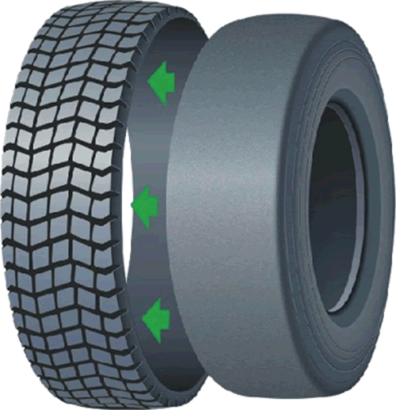
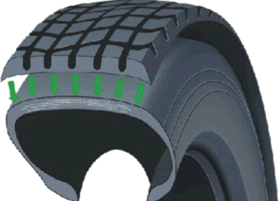
Ringtread System
Bedelco uses the Ringtread System, a complete retreading system at cold, that guarantees a perfect finish.
RINGTREAD is the only tyre retreading system that uses spliceless precured rings that adhere perfectly to the casing, without any tension or deformation to the tread profile.
Ringtread guarantees:
higher productivity
no waste
quality equivalent to a new tyre

Slide 5
Why retread tyres?
Properly done retread tyres are just as reliable as new ones
Retreading is a smart process that clearly meets our customers' safety criteria, whilst respecting the environment and preserving resources
contain up to 75% recycled content
retreading is recycling with long term sustainability

Slide 6
Things to know
retreading a truck tyre consumes much less fuel than producing a new one
at the end of its useful life, 80% of a tyre can still be used
producing a truck tyre can require up to 80 kilos of blended rubber, while retreading uses a maximum of 30 kilos
truck tyres can be retreaded up to three times, thus enabling three times the resources and energy to be saved and ensuring a corresponding reduction in waste
Bedelco provides durable retread solutions, with quick turn-times for your fleet's trucks tyres.

Slide 7
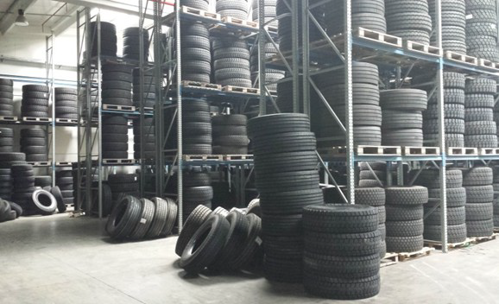
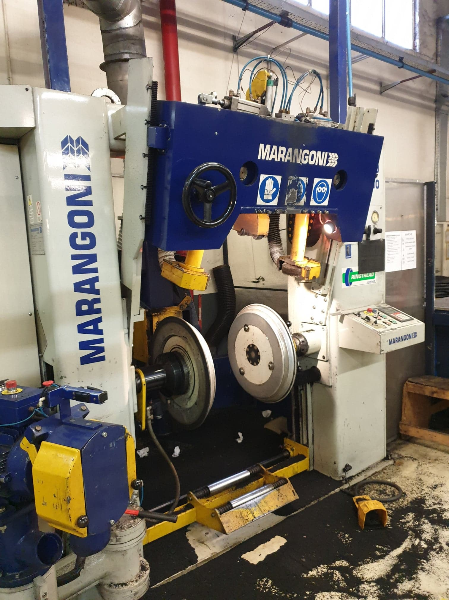
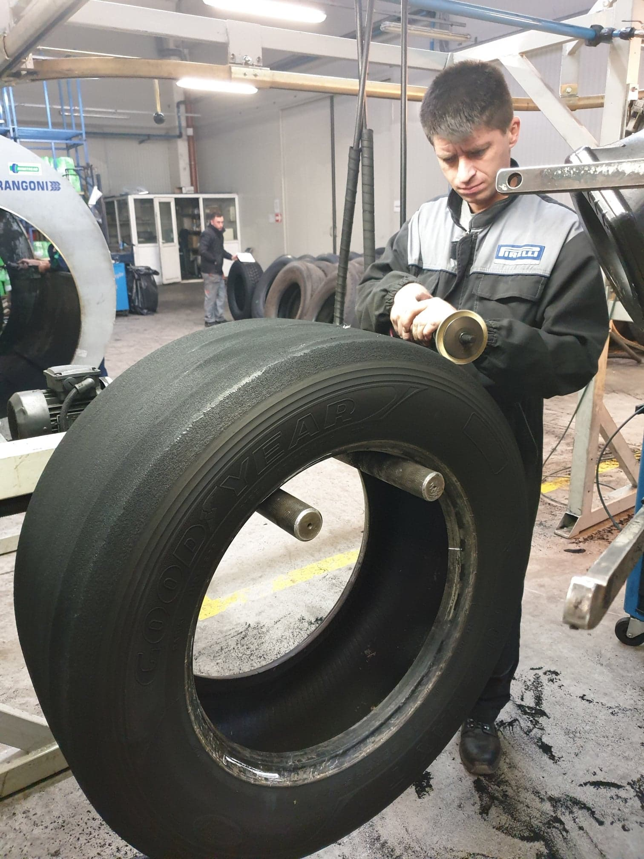
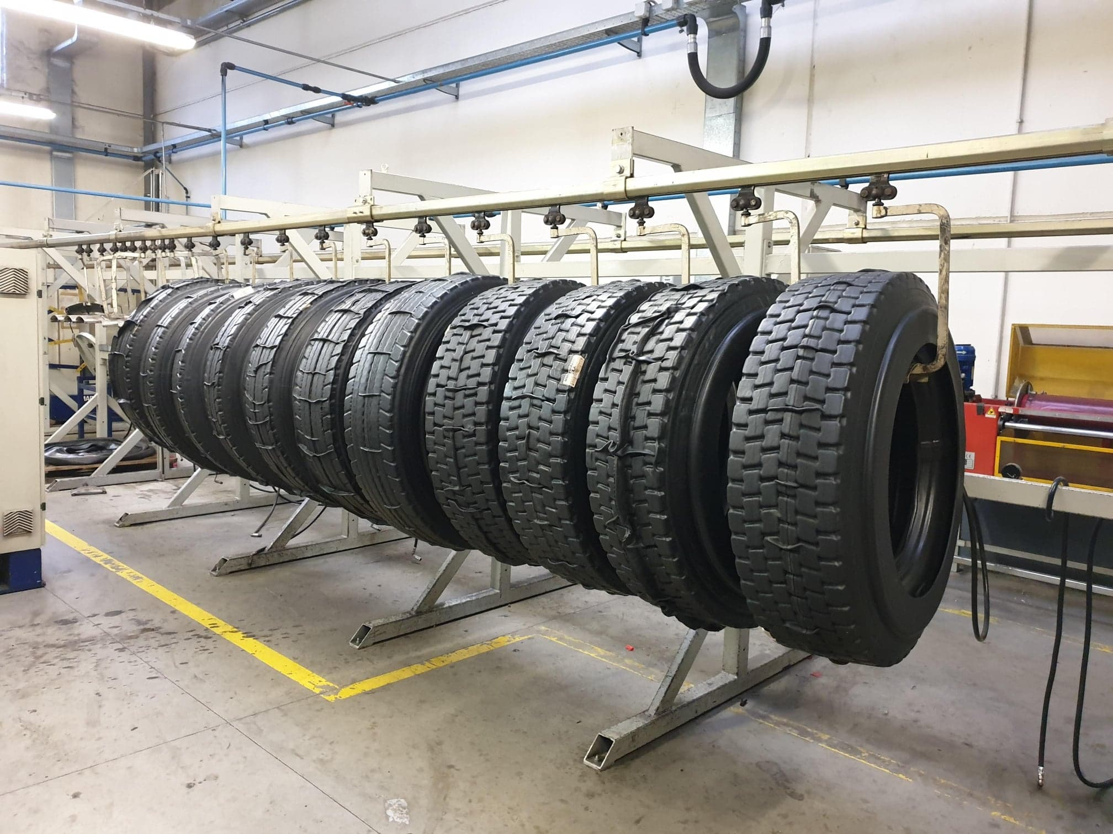
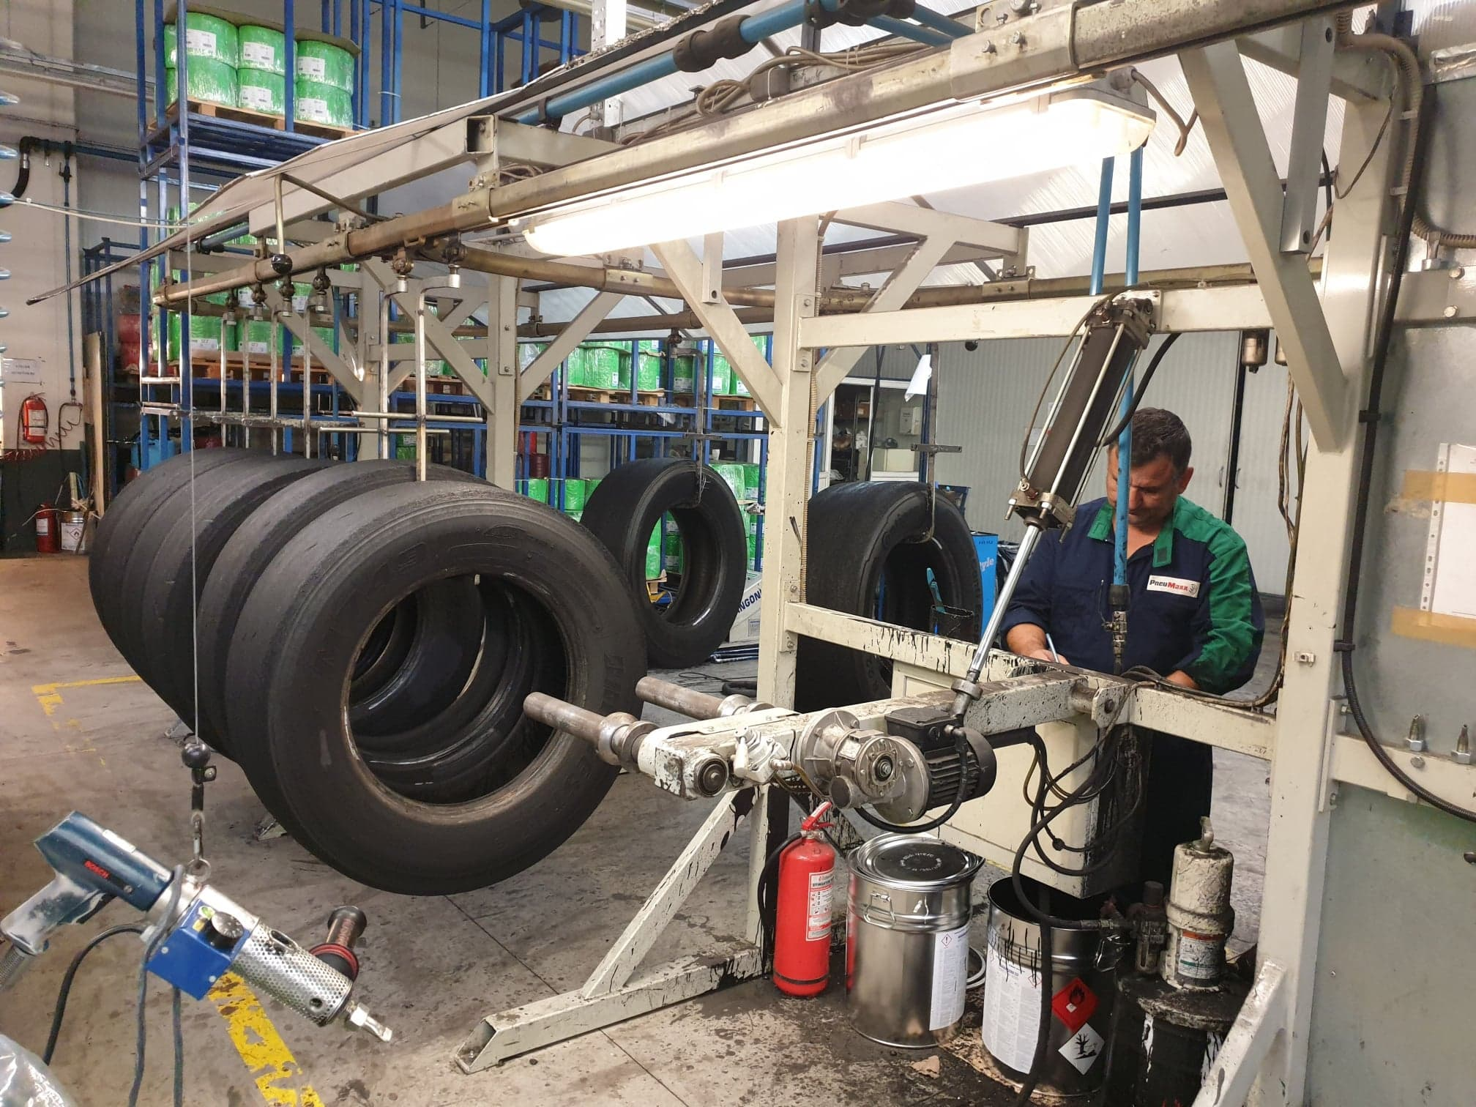
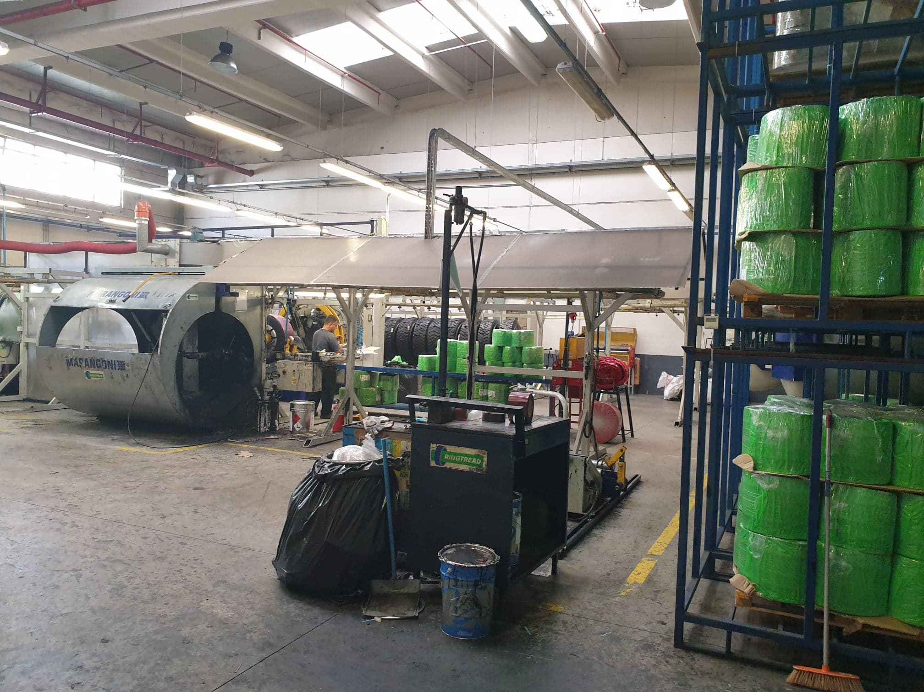
Our retreading plant in Romania

Slide 8
Retreads worldwide
• 80% of the tyres used by the commercial aviation industry are retreaded
• nearly 100 % of the world’s airlines use retreaded tyres
• nearly 100% of off-the-road, heavy duty vehicles use retreaded tyres
• school buses and municipal vehicles use retreaded tyres
• federal and military vehicles use retreaded passenger, truck and aircraft tyres
• trucking fleets and overnight delivery vehicles use retreaded tyres
• taxi fleets, race cars and industrial vehicles use retreaded tyres
• fire trucks and other emergency vehicles use retreaded tyres
• farm tractors and other agricultural equipment use retreaded tyres
• millions of passenger car owners use retreaded tyres

Slide 9
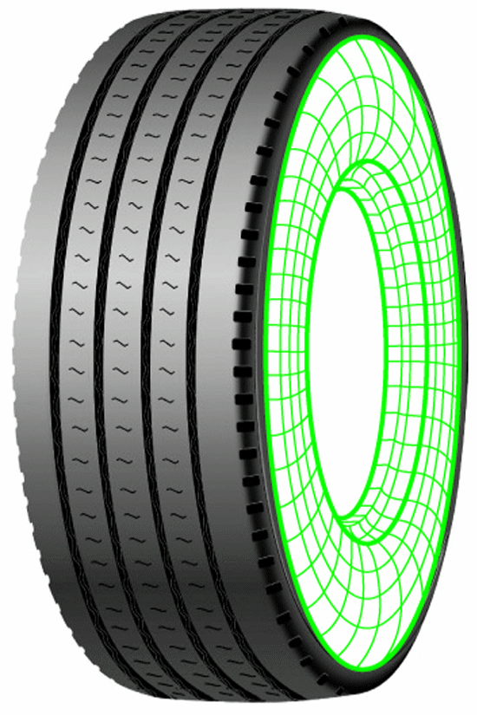
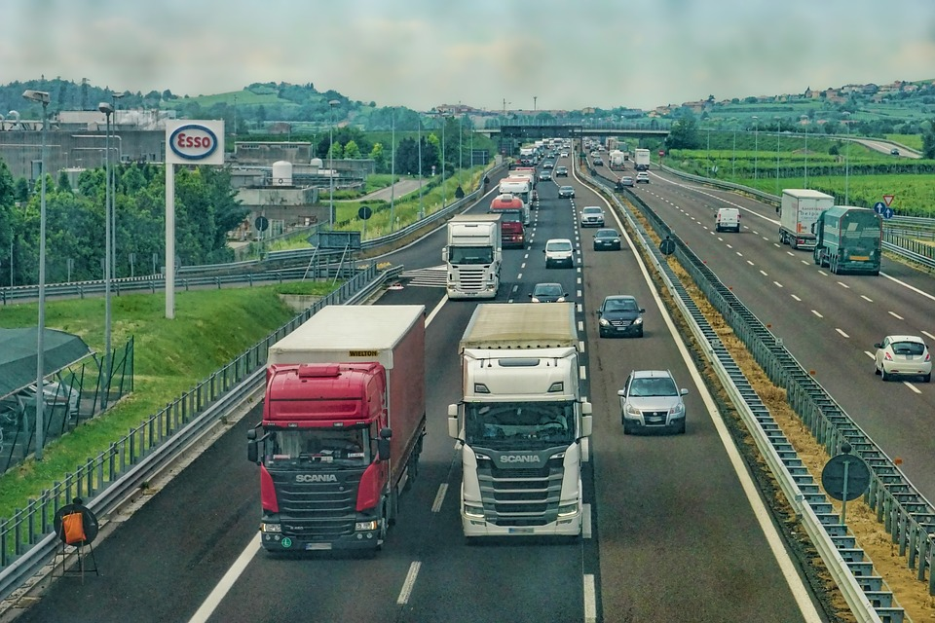
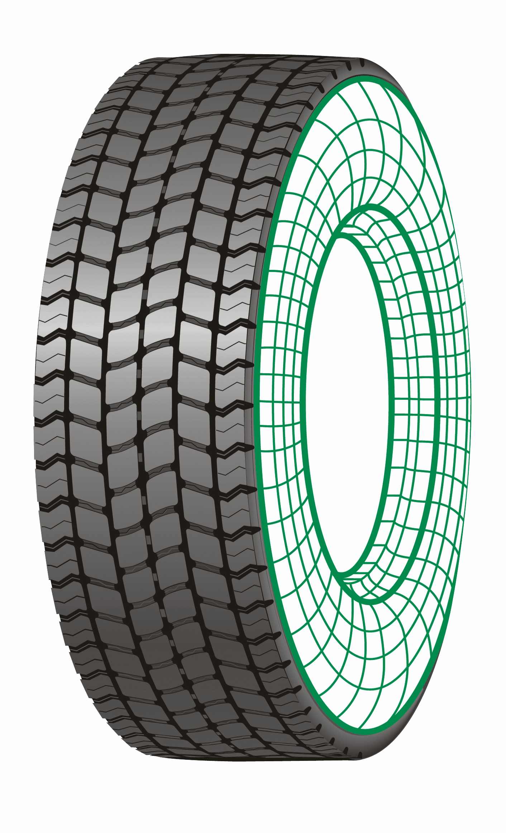
Bedelco offers retread tyres for :
Long roads, highways

Slide 10
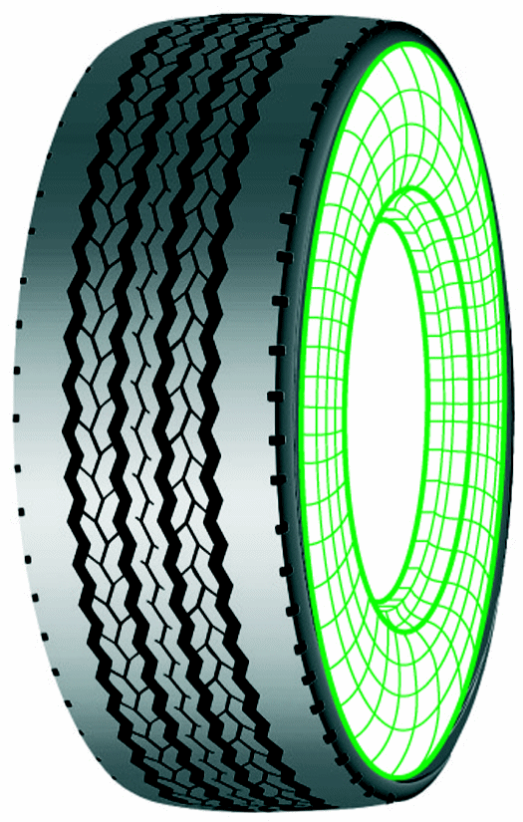
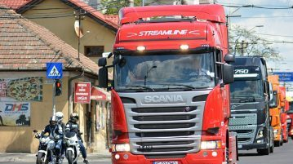
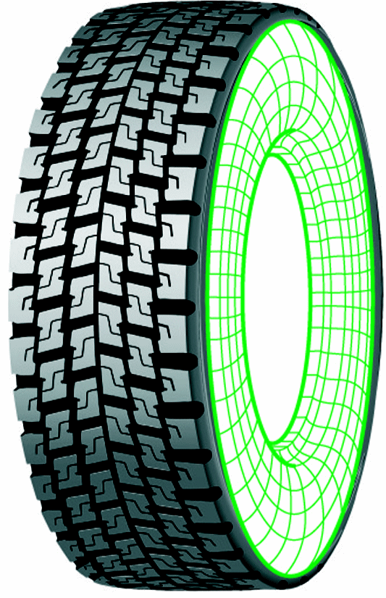
Bedelco offers retread tyres for :
National roads, regional

Slide 11
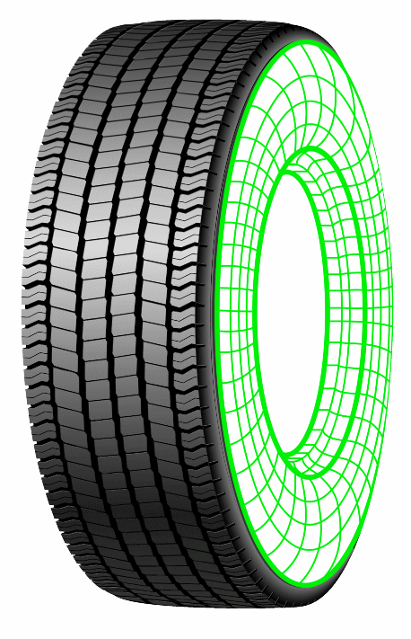
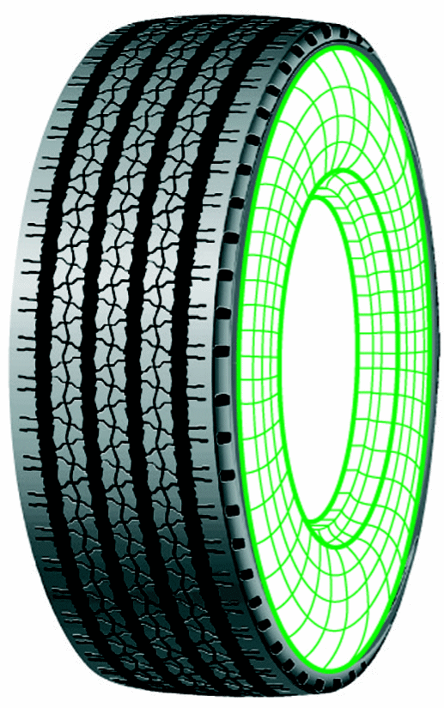
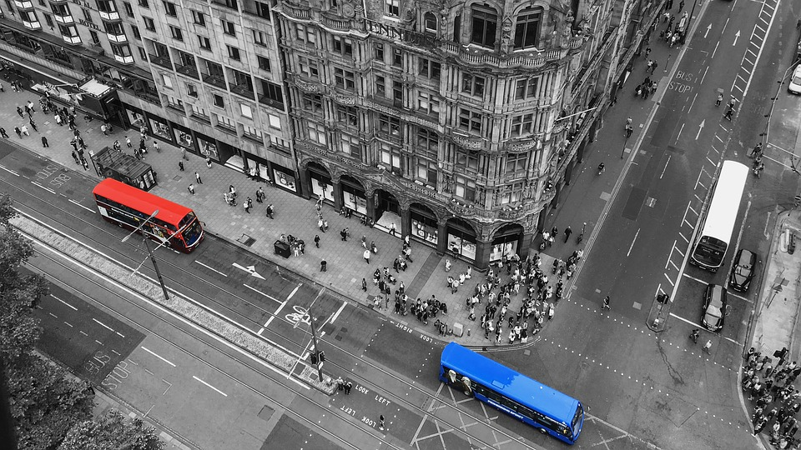
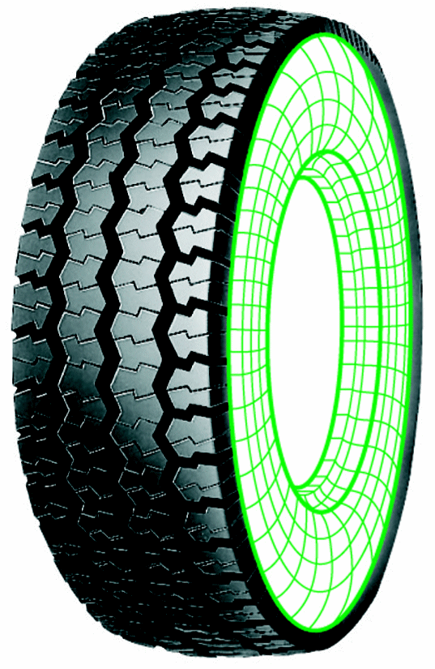
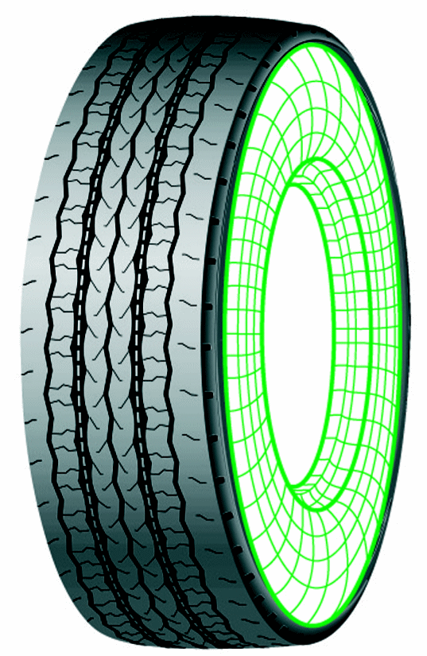
Bedelco offers retread tyres for :
Urban and interurban

Slide 12
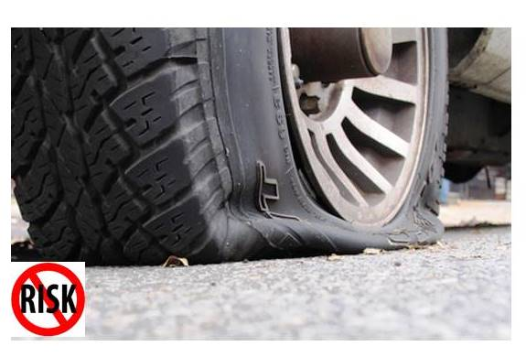
Reliability
Safe casings
+
Low heating
+
No weak points
=
NO RISK OF BREAKING

Slide 13
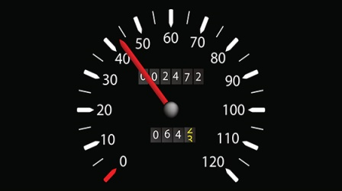
More mileage
Regular wear
+
Mix of high technology rubber
REDUCING TREAD CONSUMPTION
=
MORE MILEAGE WITH ONE TYRE

Slide 14
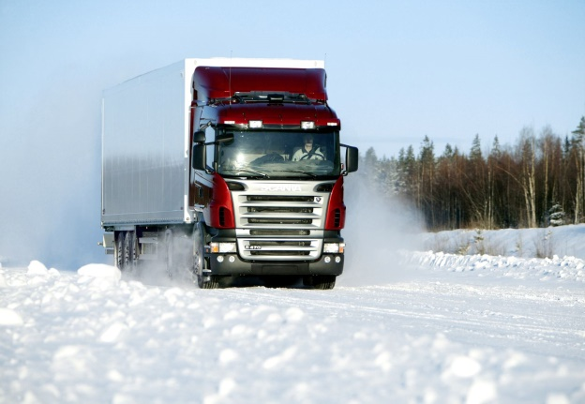
More grip
No profile deformation
TOTAL GRIP
+
Low oil mixtures
MORE TRACTION ON SLIPPERY SURFACES
=
SAFETY IN THE MOST SEVERE CONDITIONS

Slide 15
Fuel cost savings
No joints
Low resistance on rolling
Profile uniformity
Rolling uniformity
=
FUEL COST SAVINGS

Slide 16
Why Bedelco?
we know how to recommend the tyres that make the most sense for your fleet and your budget.
we’ll also work with you to create a fleet maintenance program that maximizes your vehicle potential without the high price tag.
Retread - the value of a new tyre for a lower price.

